Slide 1

Metadata & Persistent identifiers
Espen Åberg
Data Steward
ELIXIR Norway/BioMedData
Illustrative Icons from Font Awesome licensed under Creative Commons Attribution 4.0 International License

Slide 2

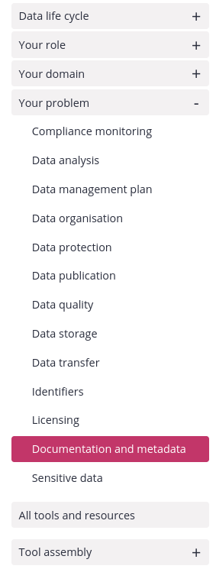
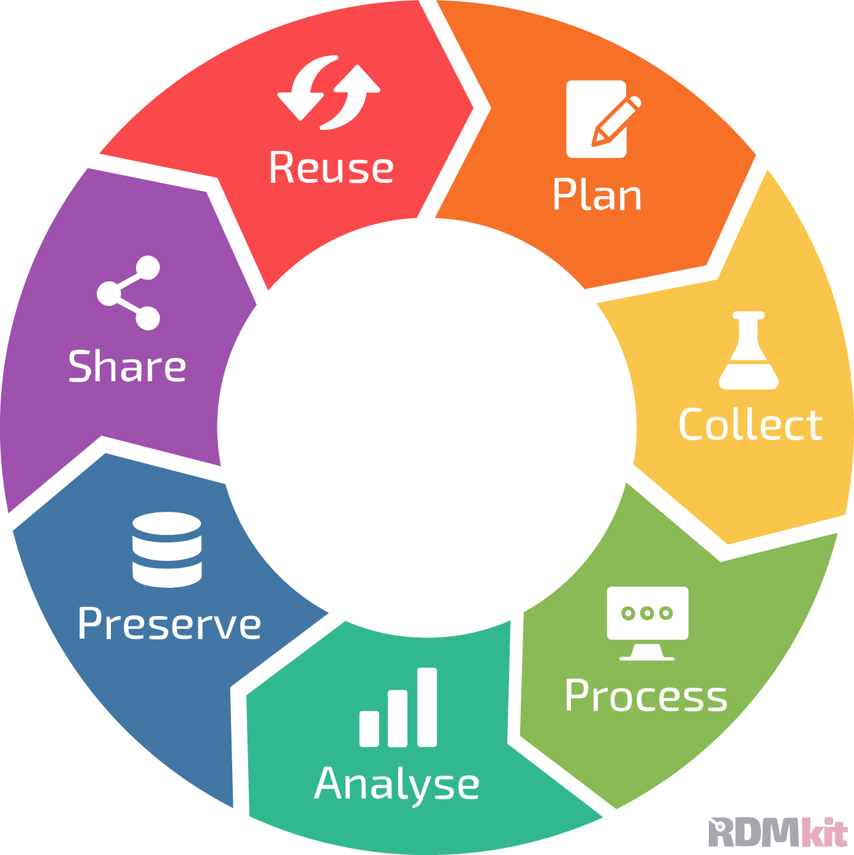
Link to RDMkit: https://rdmkit.elixir-europe.org/

Slide 3
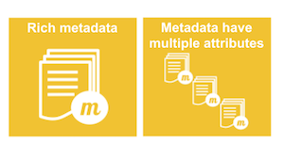
What is metadata?
Has a useful purpose
Can be acted upon and processed by humans and machines
“Metadata is constructed, constructive, and actionable.”
Definition from Karen Coyle, Digital Librarian and Author of Coyle's InFormation
“information about something”
“data about data”
“Data is content, and metadata is context”
"Metadata is a Love Note to the Future"
FAIR illustrations icons from ARDC 2018 licensed under Creative Commons Attribution 4.0 International License

Slide 4
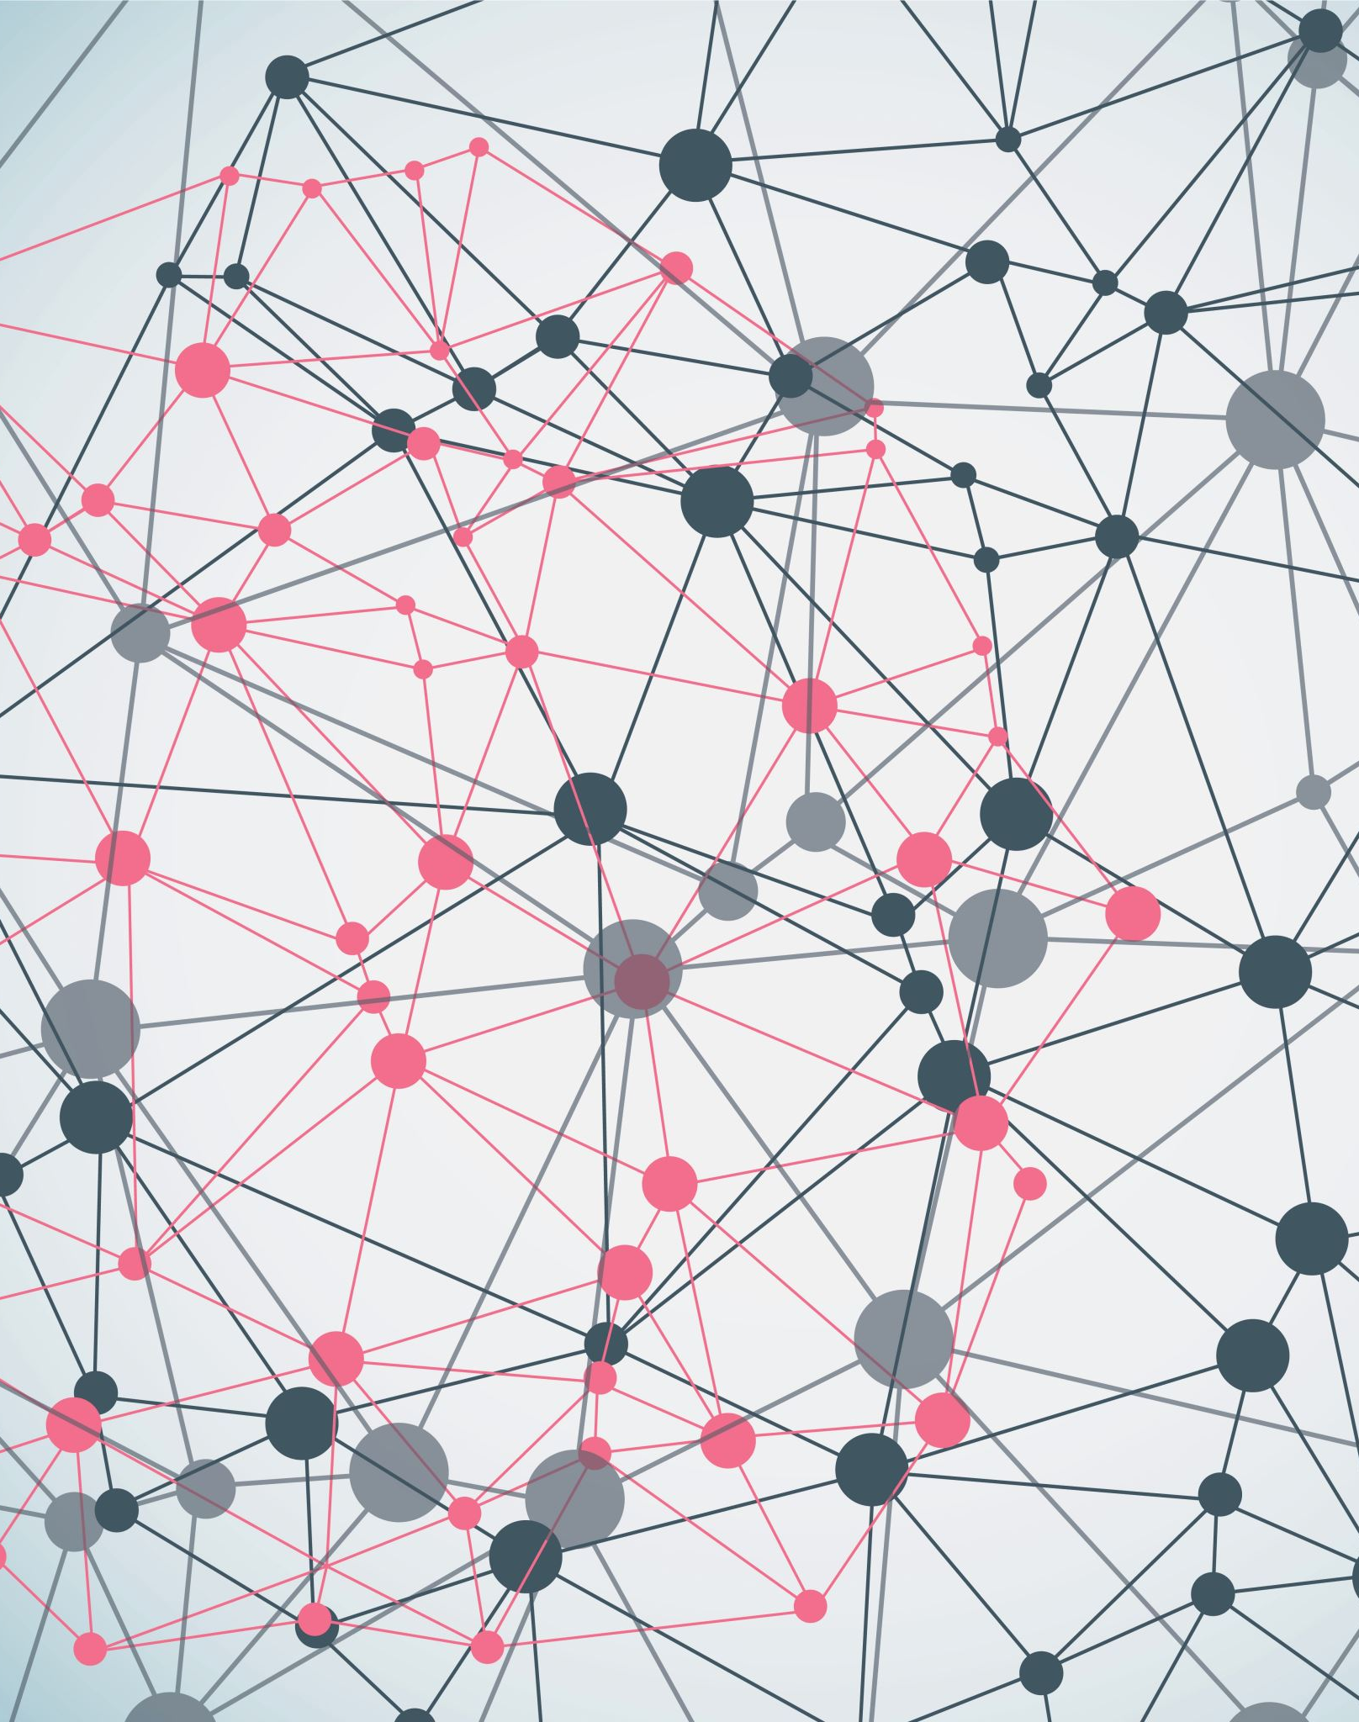
Why do I care?
Metadata facilitates organization, indexing, discovery, access, analysis, and use of data.
Metadata presence and quality (or the lack thereof) can significantly help or hinder time and money expenditures in research activities.

Slide 5
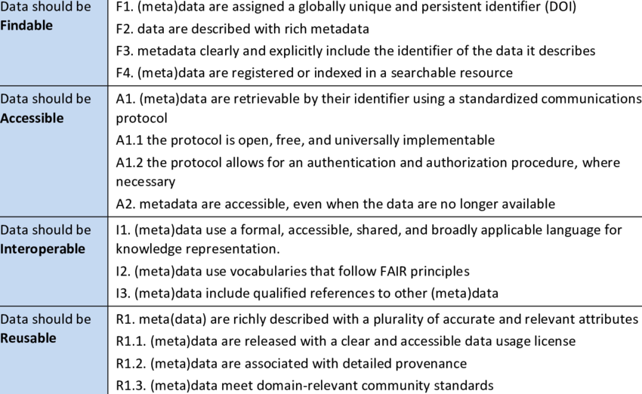
Metadata helps make data FAIR
Medyckyj-Scott, David et al. (2016).

Slide 6
Experimental design
“Data”
“Metadata”
Outcome = Treatment effect + Biological effect + Technical effects + Error
Environment
Compound
Infection
Inhibitor
siRNA
sgRNA
Dose
Time
Sex
Age
Weight
Litter
Genotype
Species
Cell line
Operator
Batch
Plate
Cage
Array
Flowcell
Instrument
Day
Order
Source
Experimental
Treatment
Sampling
Measurement
Lazic, S.E. (2016). Cambridge University Press.

Slide 7
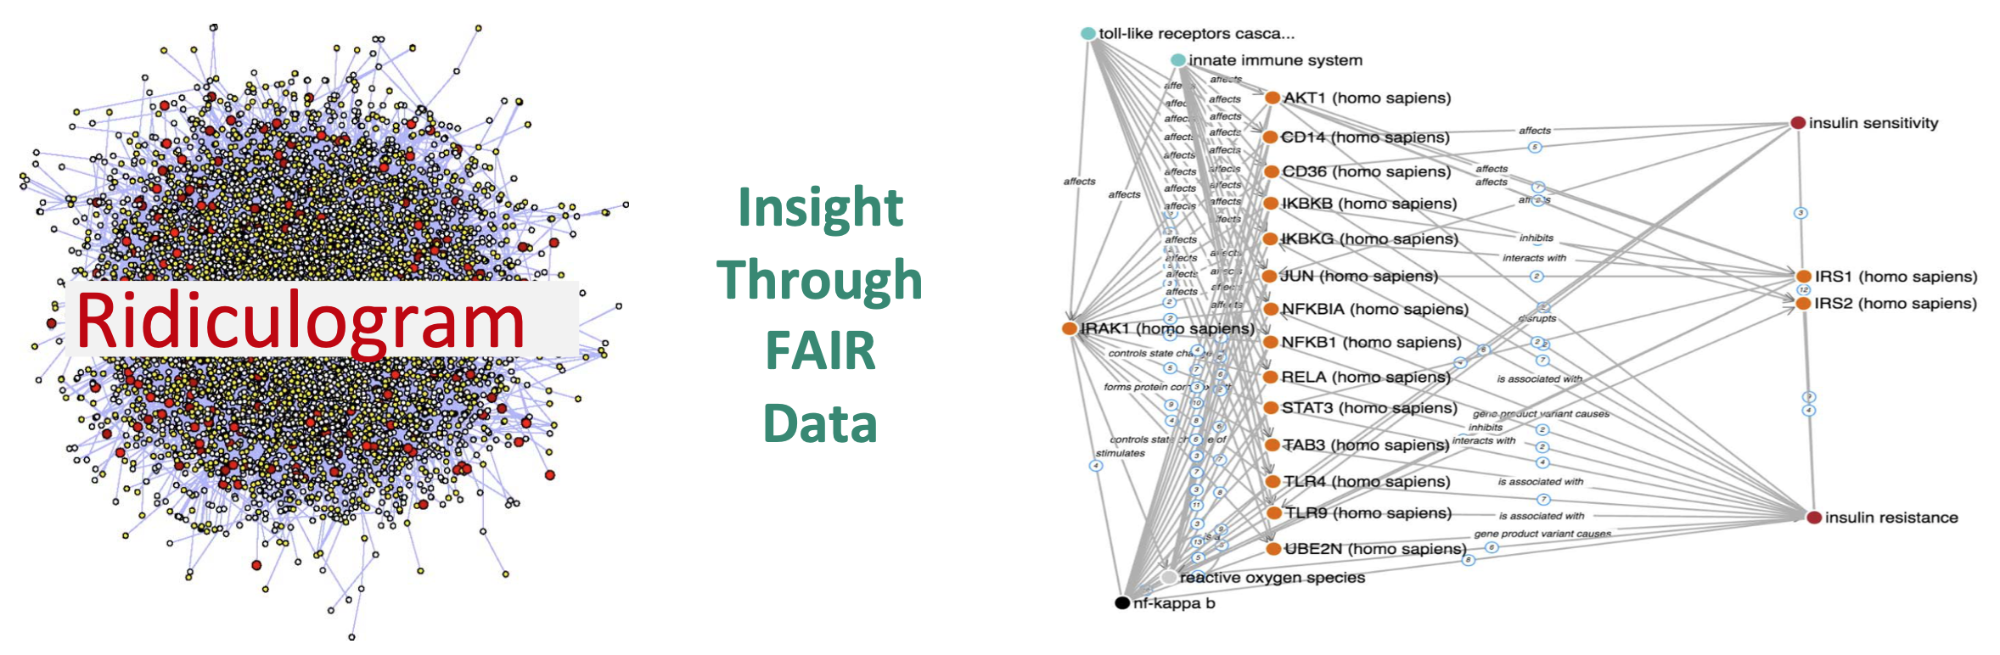
Helps to gain insight
“If data is the new oil, metadata is the refinery" — Adam Rauh

Slide 8
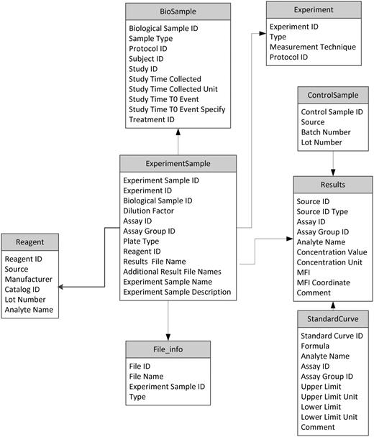
”Rich” Metadata
Authorship:
Creator
Creator date
Modified date
Publisher
Owner
Contact
Descriptive:
Title
Description
Keywords
Theme
Main subject
Version
Review changes
Validation status
Size
Format
Language
Semantic model
Conforms to standard/schema
01000110 01100001
01110011 01110100
01110001 01100110
01101001 01101100
01100101
Digital object (DO)
Metadata
Context:
Project description
Temporal coverage
Spatial coverage
Creation process
Source description
Quality:
Quality parameters
Accessibility conditions:
License
Access rights
Download/access URL

Slide 9
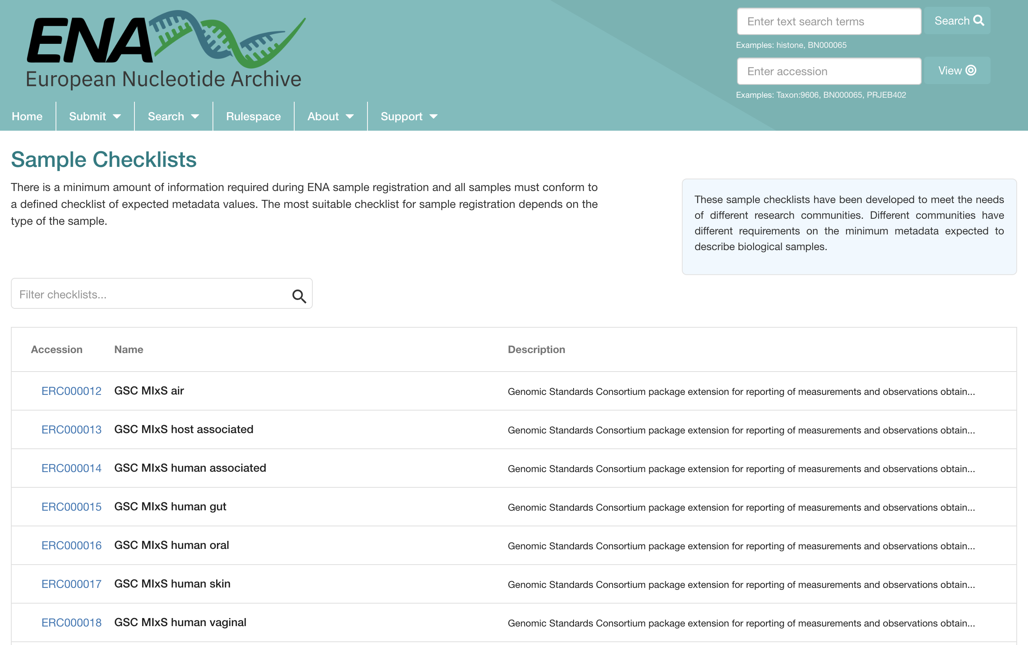
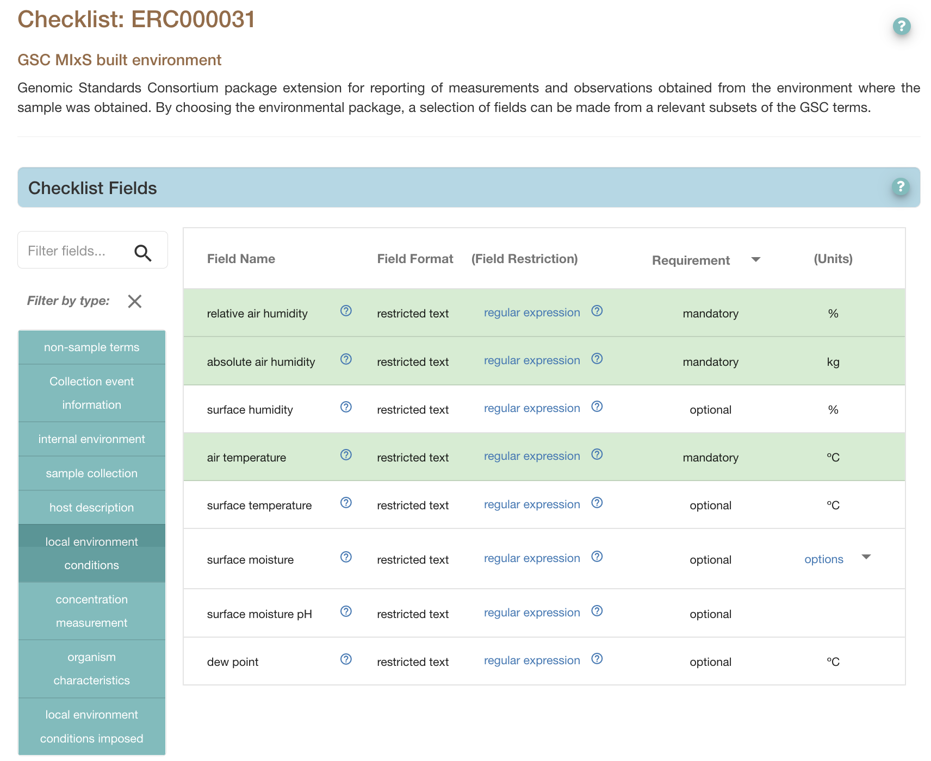
Metadata templates/checklists
https://www.ebi.ac.uk/ena/browser/checklists

Slide 10
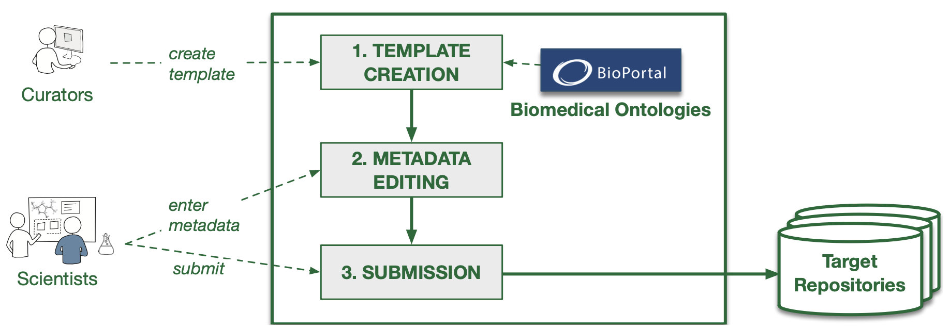
Metadata Submission Workflow
Contribute
Search and reuse
Figure 2 from: Using Semantic Technologies to Enhance Metadata Submissions to Public Repositories in Biomedicine

Slide 11
Make it visible
With Rich Metadata
Digital object (DO)
TAG it with a PID

Slide 12
PIDs helps make data FAIR
Medyckyj-Scott, David et al. (2016).

Slide 13
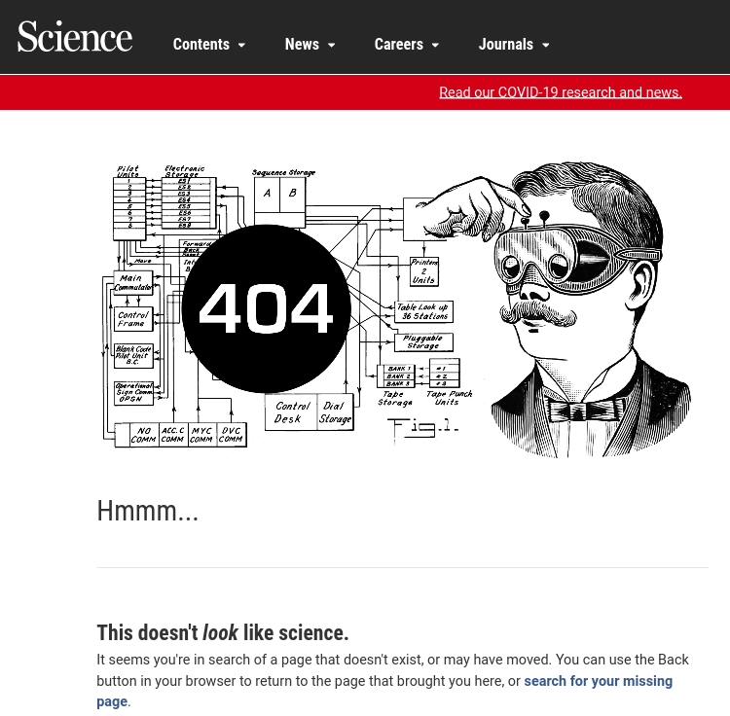
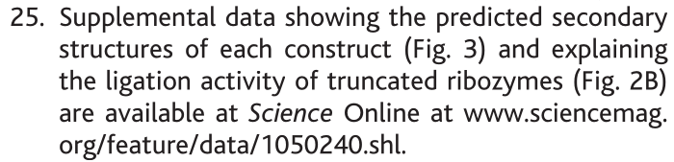
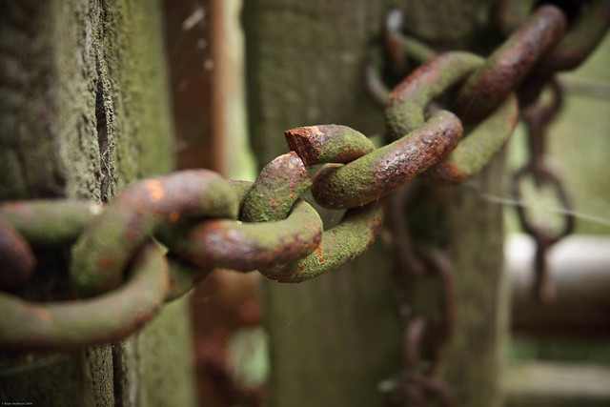
Why don’t I just use a link (URL)?
“Link rot”
farm3.staticflickr.com

Slide 14
PID = PDI = GUID
PID = Persistent Identifier
PDI = Persistent Digital Identifier
GUID = Globally Unique Identifier
Physical objects: a dog, building, microscope, star, person etc
It doesn’t “rot”
A persistent identifier (PID) is a long-lasting reference to a resource
Somebody commits to keep it alive
People AND computers can find it
Digital Objects: data, collections, metadata, software, publications, configurations, categories, workflows etc
globally unique string of characters

Slide 15
A PID consists of two components:
Visible string of letters and/or numbers
1. A unique identifier
2. A service that locates the resource (or “resolves” it)
Behind the scene

Slide 16
Persistent over time
.. by design
today
…
...
...
2030
ID is unique and always the same
11839/abc123
11839/abc123
http://www.example.com/
http://www.moved.com/
111000010001111
URL may change over time
111000010001111
Supports access to resource as it moves from one location to another.
Modified from https://b2drop.eudat.eu/s/TCYdyf3eqwE0Ust

Slide 17
Persistent over time
.. by design
today
…
...
2030
Stable
11839/abc123
11839/abc123
http://www.example.com/
http://www.moved.com/
Update information
Redirection
111000010001111
Responsibility of the PID owner to keep it up-to-date when the resource changes
111000010001111
Modified from https://b2drop.eudat.eu/s/TCYdyf3eqwE0Ust

Slide 18
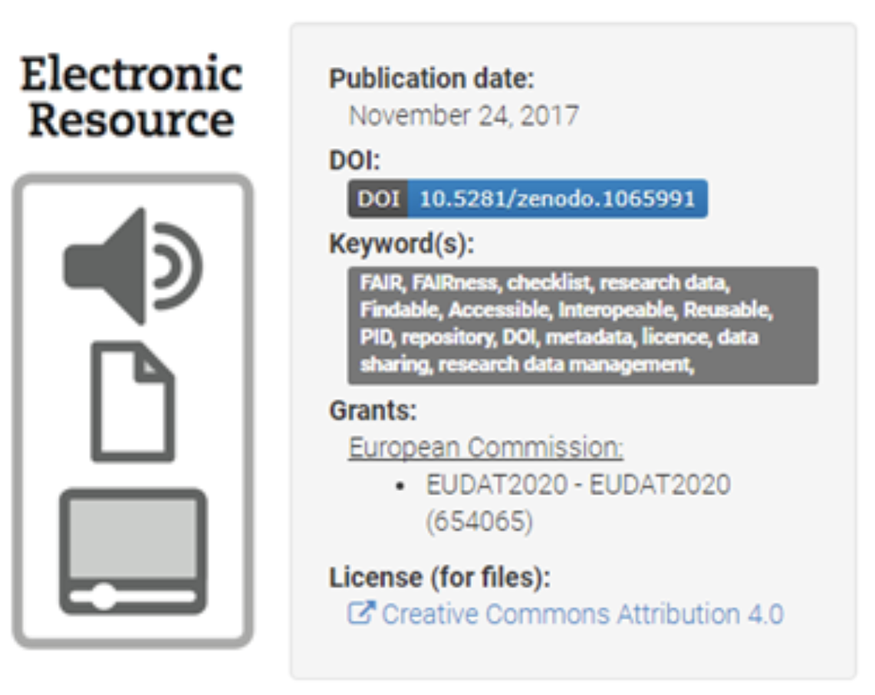
Priciple:
PID Service
TAG
PID
URL
https://www.clarin.eu/sites/default/files/pid-CLARIN-ShortGuide.pdf
Digital object (DO)
01000110 01100001
01110011 01110100
01110001 01100110
01101001 01101100
01100101

Slide 19
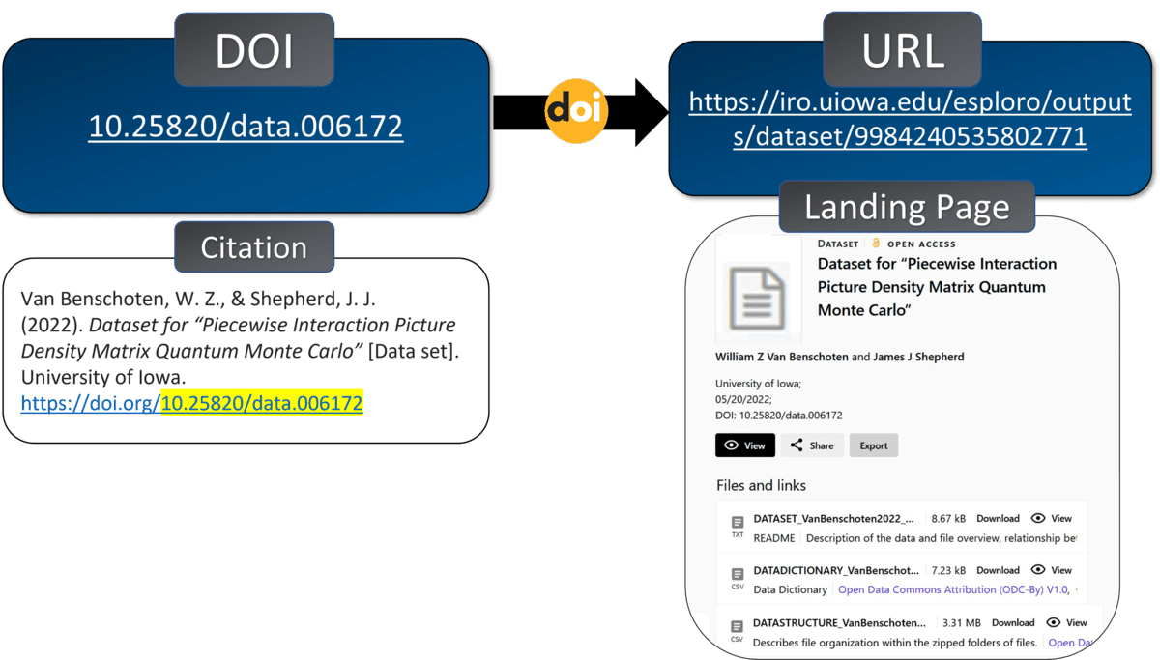
Example
https://blog.lib.uiowa.edu/news/2023/03/07/the-power-of-persistent-identifiers-in-data-sharing/

Slide 20


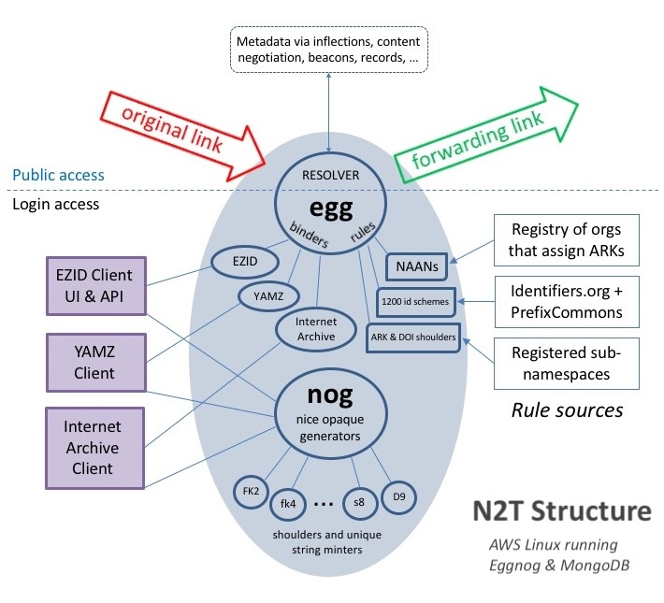
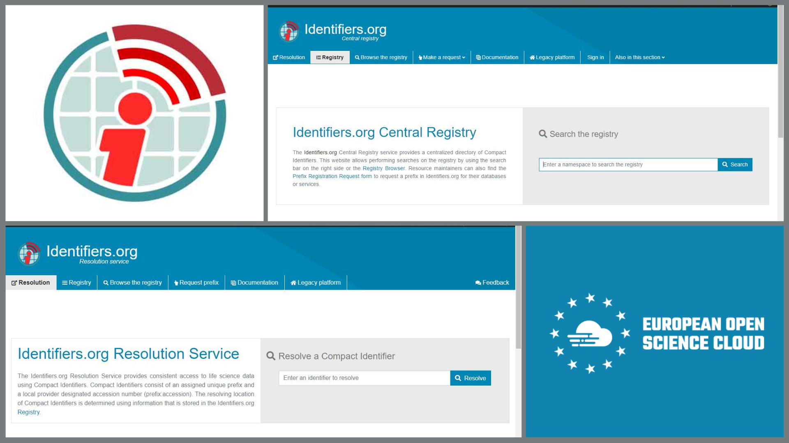
Different systems
Some Common Identifiers:
Digital Object Identifiers (doi:10.1186/2041-1480-3-9)
Handles (hdl:2381/12775)
URN (urn:isbn:0451450523)
Archival Resource Keys (ARK) (ark:/13030/tf5p30086k)
Persistent Uniform Resource Locator (PURL)
Resolver Services
N2T (Name-to-Thing)
Identifiers.org
https://arks.org/about/n2t-global-resolver/
https://eosc-portal.eu/news-and-events/news/identifiers-ensuring-robust-and-reliable-access-life-sciences-data

Slide 21

How do I recognize a PID?
DOI: 10.5281/zenodo.6104400

Slide 22
Anatomy of a DOI
Means that it is actionable: you can paste in a web browser address bar and be taken to the identified source.
globally unique together
https://doi.org/ 10.5281 / zenodo.6104400
Resolver service
Directory
indicator
Suffix
Local ID = an “Accession”
Only guaranteed to be locally unique within the database or source
Prefix
Assigned by
DOI Foundation
Assigned by RA members (registrants)
e.g. Zenodo
Assigned by
DOI Registration Agencies (RAs)
e.g. Crossref, DataCite, etc

Slide 23










PIDs for...
People
Data and Software
Instruments
Publications
Organizations and Institutions
Funding bodies
Grants and Projects
Methods, protocols and reagents
Physical samples
Grant IDs
Instrument IDs
Funder IDs

Slide 24



PIDs connect different entities in research
Creates
Dataset #1
DOI
Creates
Writes
Uses
Writes
Cell Line #1
RRID
Writes
Cell Line #2
RRID
Article #1 DOI
Creates
Article #2 DOI
Dataset #2
DOI
Creates
Dataset #3
DOI
Creates
Writes

Slide 25

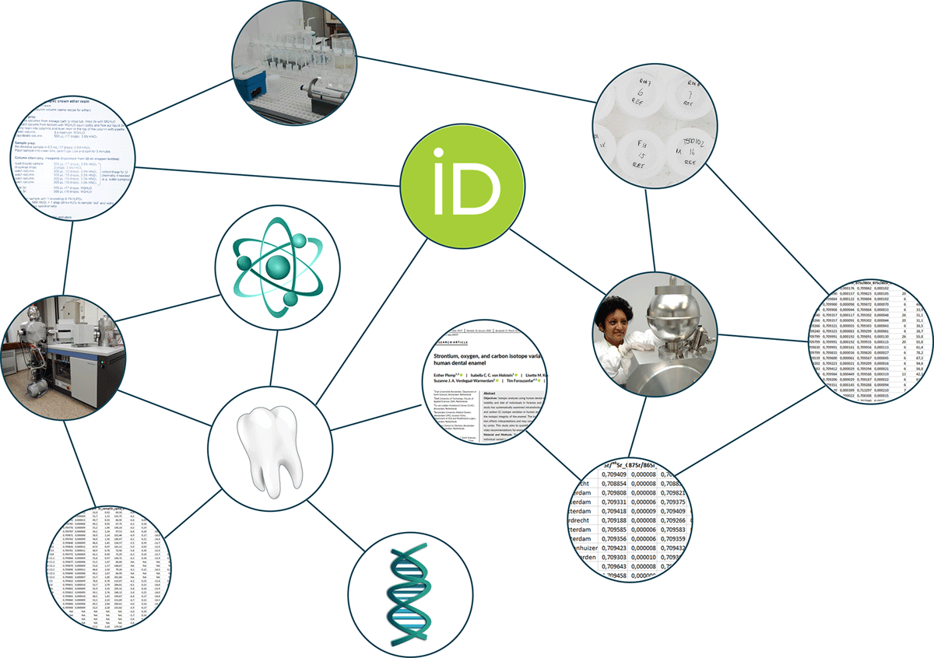
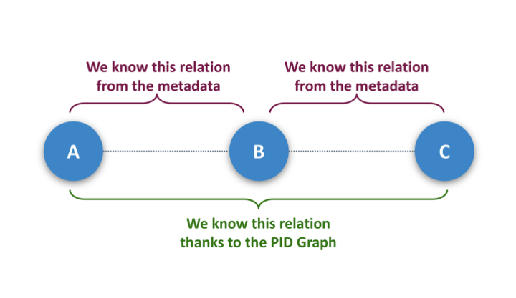

PID graphs
“I want to see all datasets funded by RCN cited by this article”
Publication
Datasets
Publication
Datasets
Publication
Funder/Grant
Datasets
Publication
Publication

Slide 26

Except where otherwise noted, this work is licensed under:
https://creativecommons.org/licenses/by/4.0/

